Slide 2
FESTIVALS AND CELEBRATIONS

Slide 3
TYPES OF FESTIVALS
Chapter 6 /social Dept/n karunambigai/SNS academy

Slide 4
NATIONAL FESTIVALS
CHAPTER 6/KARUNAMBIGAI/SOCIAL DEPT/SNS ACADEMY

Slide 5
HOW DO WE CELEBRATE NATIONAL FESTIVALS

Slide 6
CHAPTER 6/KARUNAMBIGAI/SOCIAL DEPT/SNS ACADEMY
RELIGIOUS FESTIVALS

Slide 7
DIWALI

Slide 8
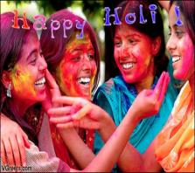
Chapter 6 /Social Dept/N karunambigai/SNS academy
HOLI

Slide 9
RAKSHA BANDHAN

Slide 11
NAVARATRI

Slide 12
GURUPURAB

Slide 13
BUDDHA PURNIMA

Slide 14
CHRISTMAS

Slide 15
RAMZAN

Slide 16
HARVEST FESTIVAL

Slide 21
Chapter 1 /Science Dept/N karunambigai/SNS academy

